Slide 1
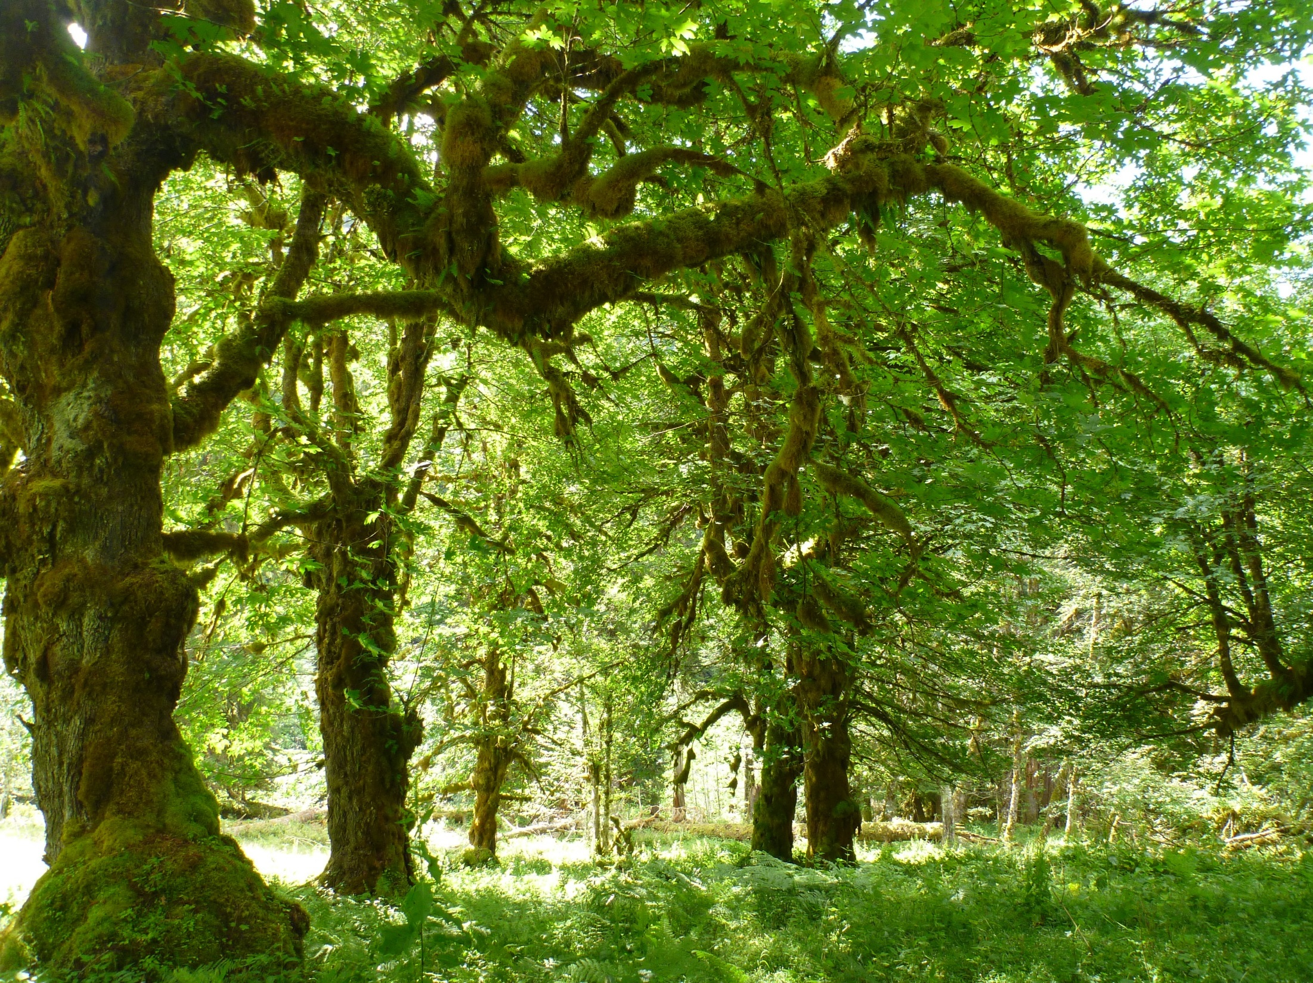
Tree-based Models Statistics for Soil Survey

Slide 2
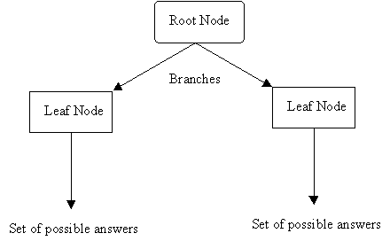
What is a Decision Tree?
Instead of fitting a model to the data, a decision tree model recursively partitions the data into increasingly homogenous groups based on values that minimize a loss function (such as Sum of Squared Errors (SSE)).
Terminal Node
Terminal Node
Notes:
How have you, or could you, use decision trees?

Slide 3
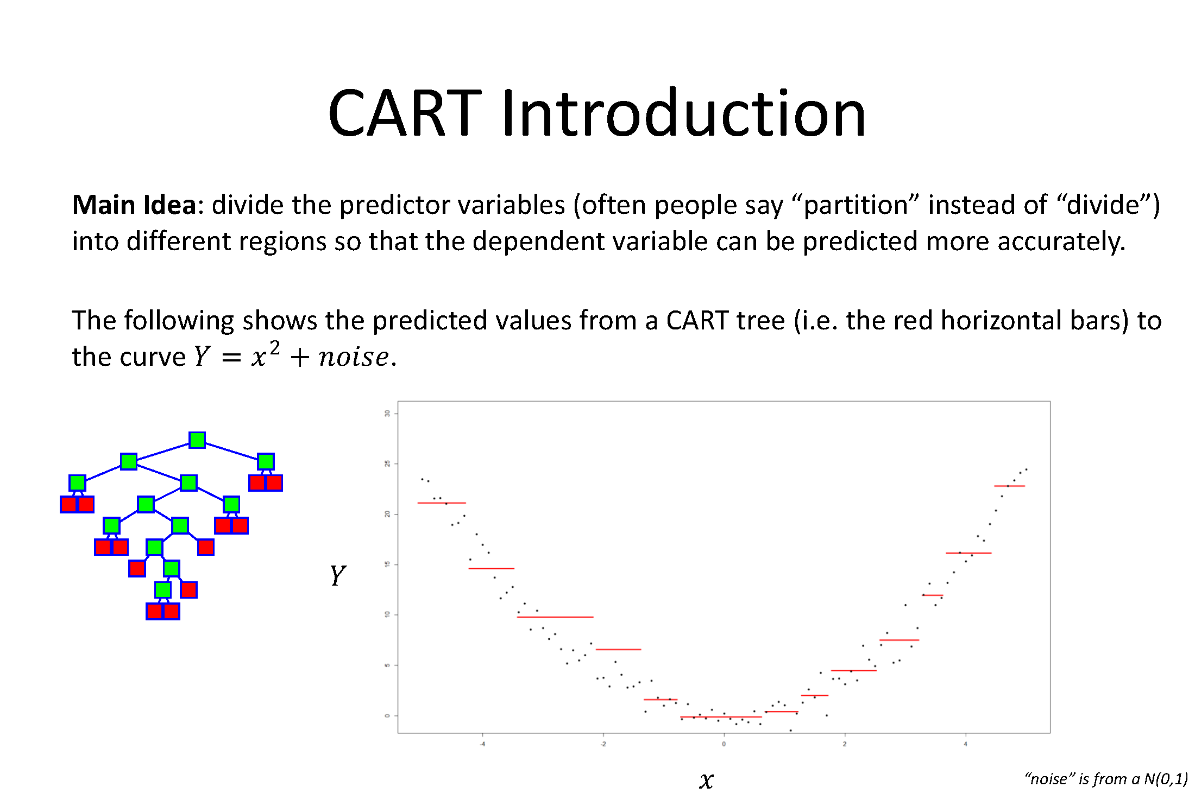

Slide 4
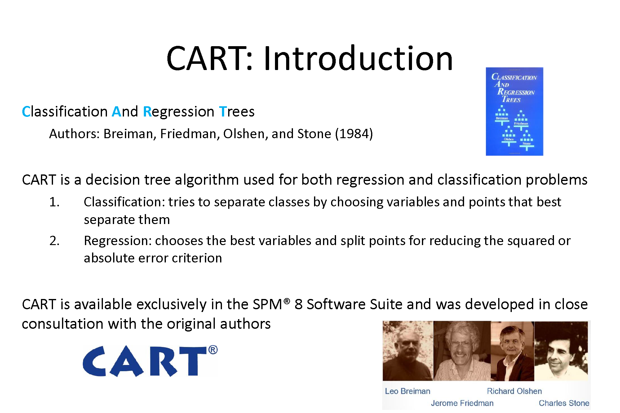

Slide 5
Example
Argillic Horizon
No
Yes
Dominant Vegetation
Base Saturation
Hardwood
Conifer, Mixed
<35%
>35%
Inceptisols
Spodosols
Ultisols
Alfisols

Slide 6
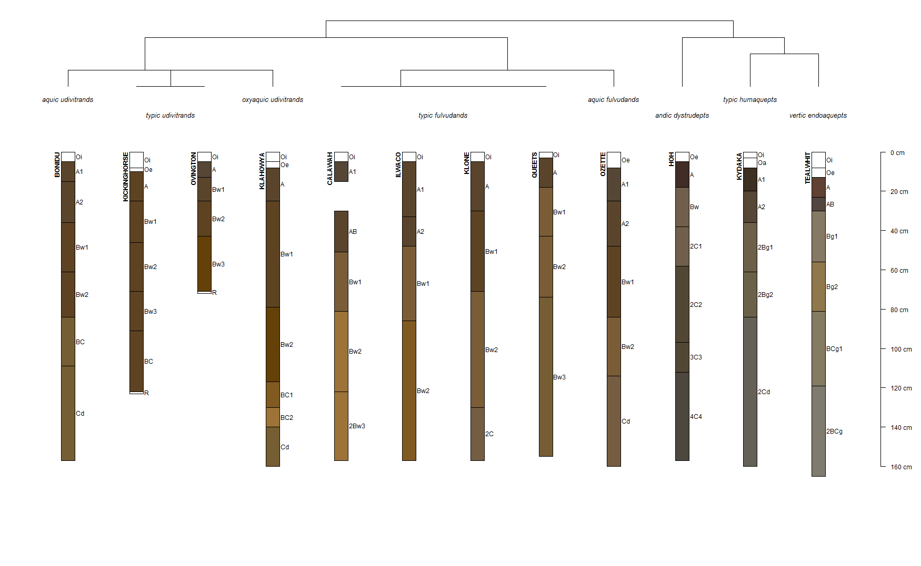

Slide 7


Slide 8
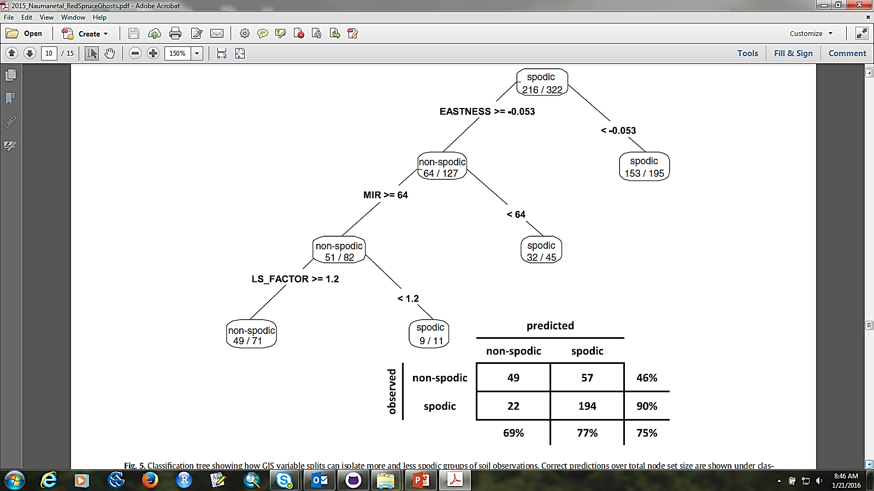
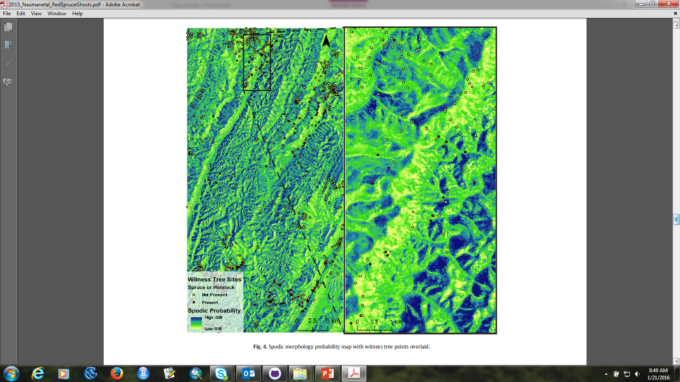
Nauman et al., 2015
Notes:
Rpart Example – spodic probability (to aid in interpretation). Interpolated random forest model.

Slide 9
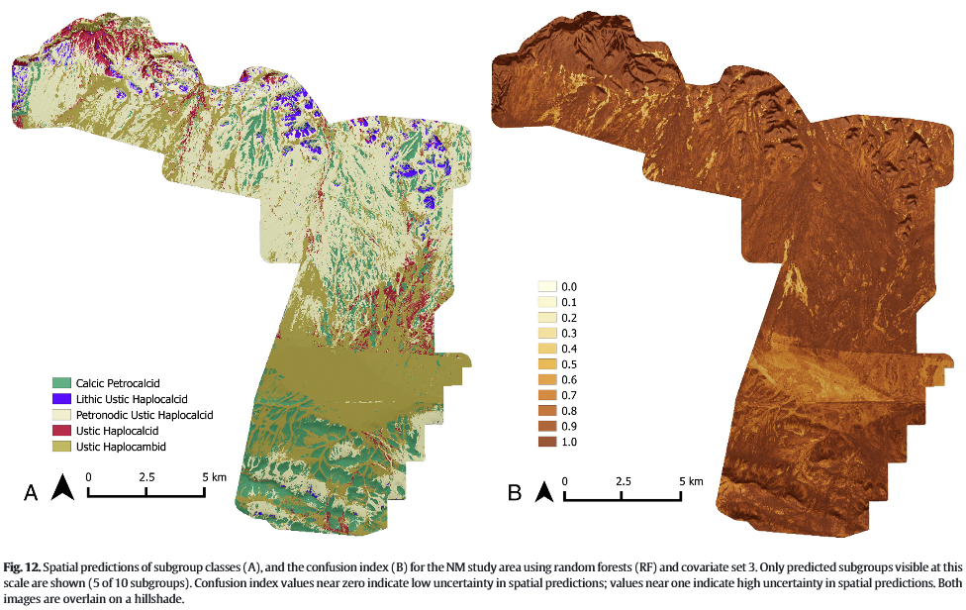
Brungard et al., 2015
Notes:
Brungard et al., 2015 compared many different machine learning techniques in 3 semi-arid regions, including knn, linear discriminant analysis, multinomial logistic regression, classification tree, support vector machines, etc., and found random forest to perform the best for soil taxonomic class prediction. This figure shows the interpolated RF model on the left and confusion index on the right. When presenting interpolated models, it is always best to include an interpolated confusion index to show where the model strengths and weaknesses are.
Sequeira et al., 2014 and Yoast, 2015 successfully used RF as a pedotransfer function to populate missing bulk density and carbon data.

Slide 10
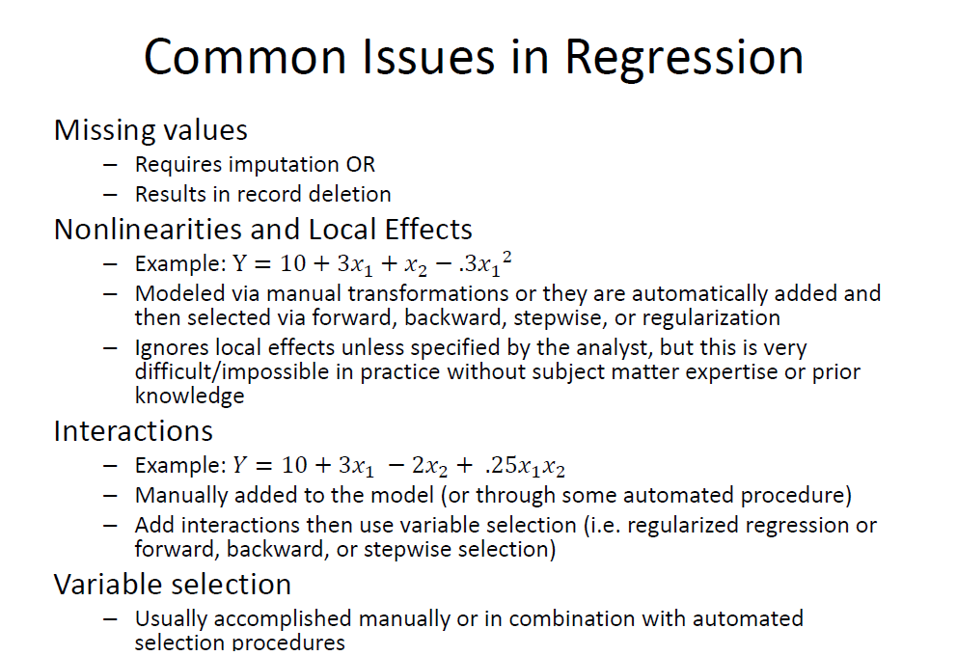

Slide 11
Advantages of Tree-based Models
Closely resemble human reasoning
Quick to execute
Do not assume or require normality
Can handle categorical AND continuous data
Offer readily interpretable results, often including graphical and tabular outputs
Can be used for classification OR regression
Can handle missing values
Can be used for exploratory data analysis AND prediction

Slide 12
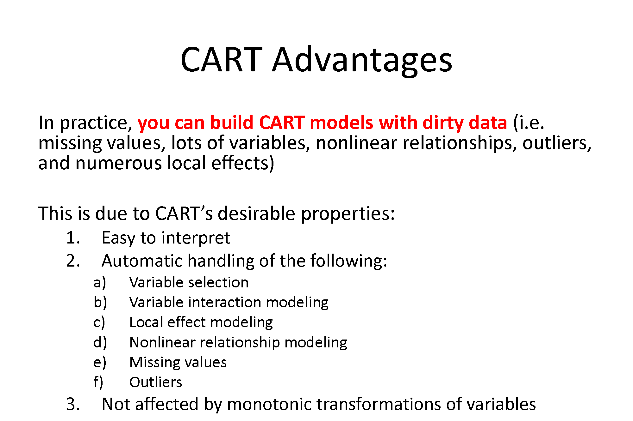

Slide 13
Two Most Common Tree-based Models in R
Recursive Partitioning (rpart)
Produces a regression or classification tree based on recursive binary splits that maximize homogeneity and minimize impurity.
Random Forest (randomForest)
Produces an ensemble of independent trees (regression or classification) that are built using a random subset of observations that are then split using a random subset of predictors at each node.

Slide 14
rpart algorithm
Start with all cases at the root node and select the variable/value (X=t₁) that best splits the data into homogeneous groups (sum of squared errors for regression and entropy, Gini measure, or “twoing” for classification).
If X< t₁ then the data are sent to the left; otherwise, the data are sent to the right.
Repeat this process until the objective is met.
Comments:
Once the cases are split, they are never rejoined
A given variable can be used multiple times in a tree
Pruning may be necessary to reduce over-fitting
Notes:
Tree grows upside down with root at top

Slide 15
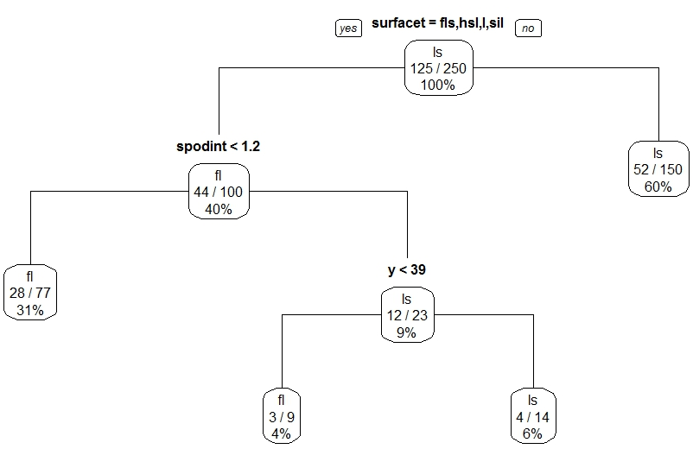
rpart – Classification Trees
Terminal nodes are categorical -- the class with the majority of votes wins.

Slide 16
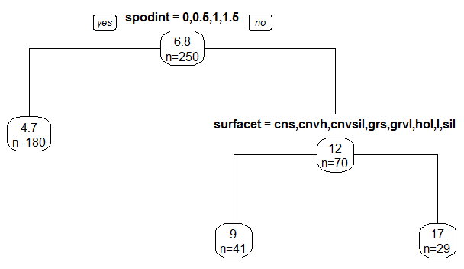
rpart – Regression Trees
Terminal nodes represent the mean of the observations in that node.

Slide 17
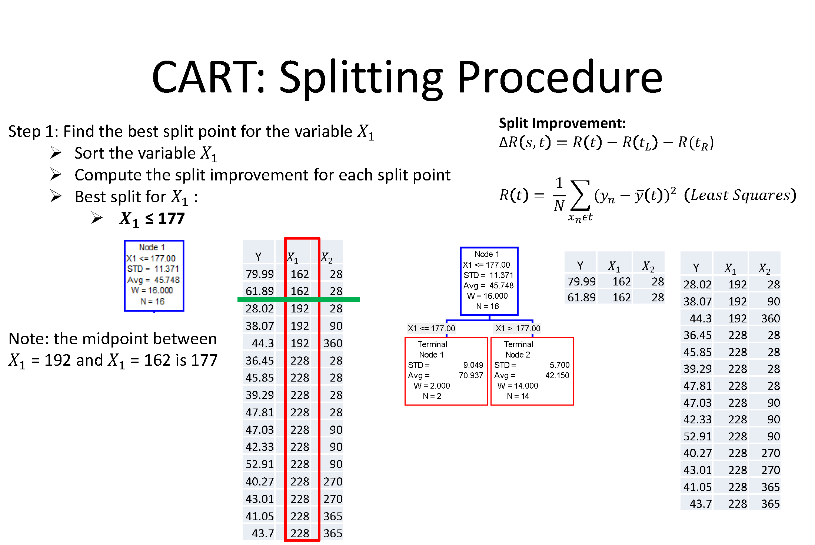

Slide 18
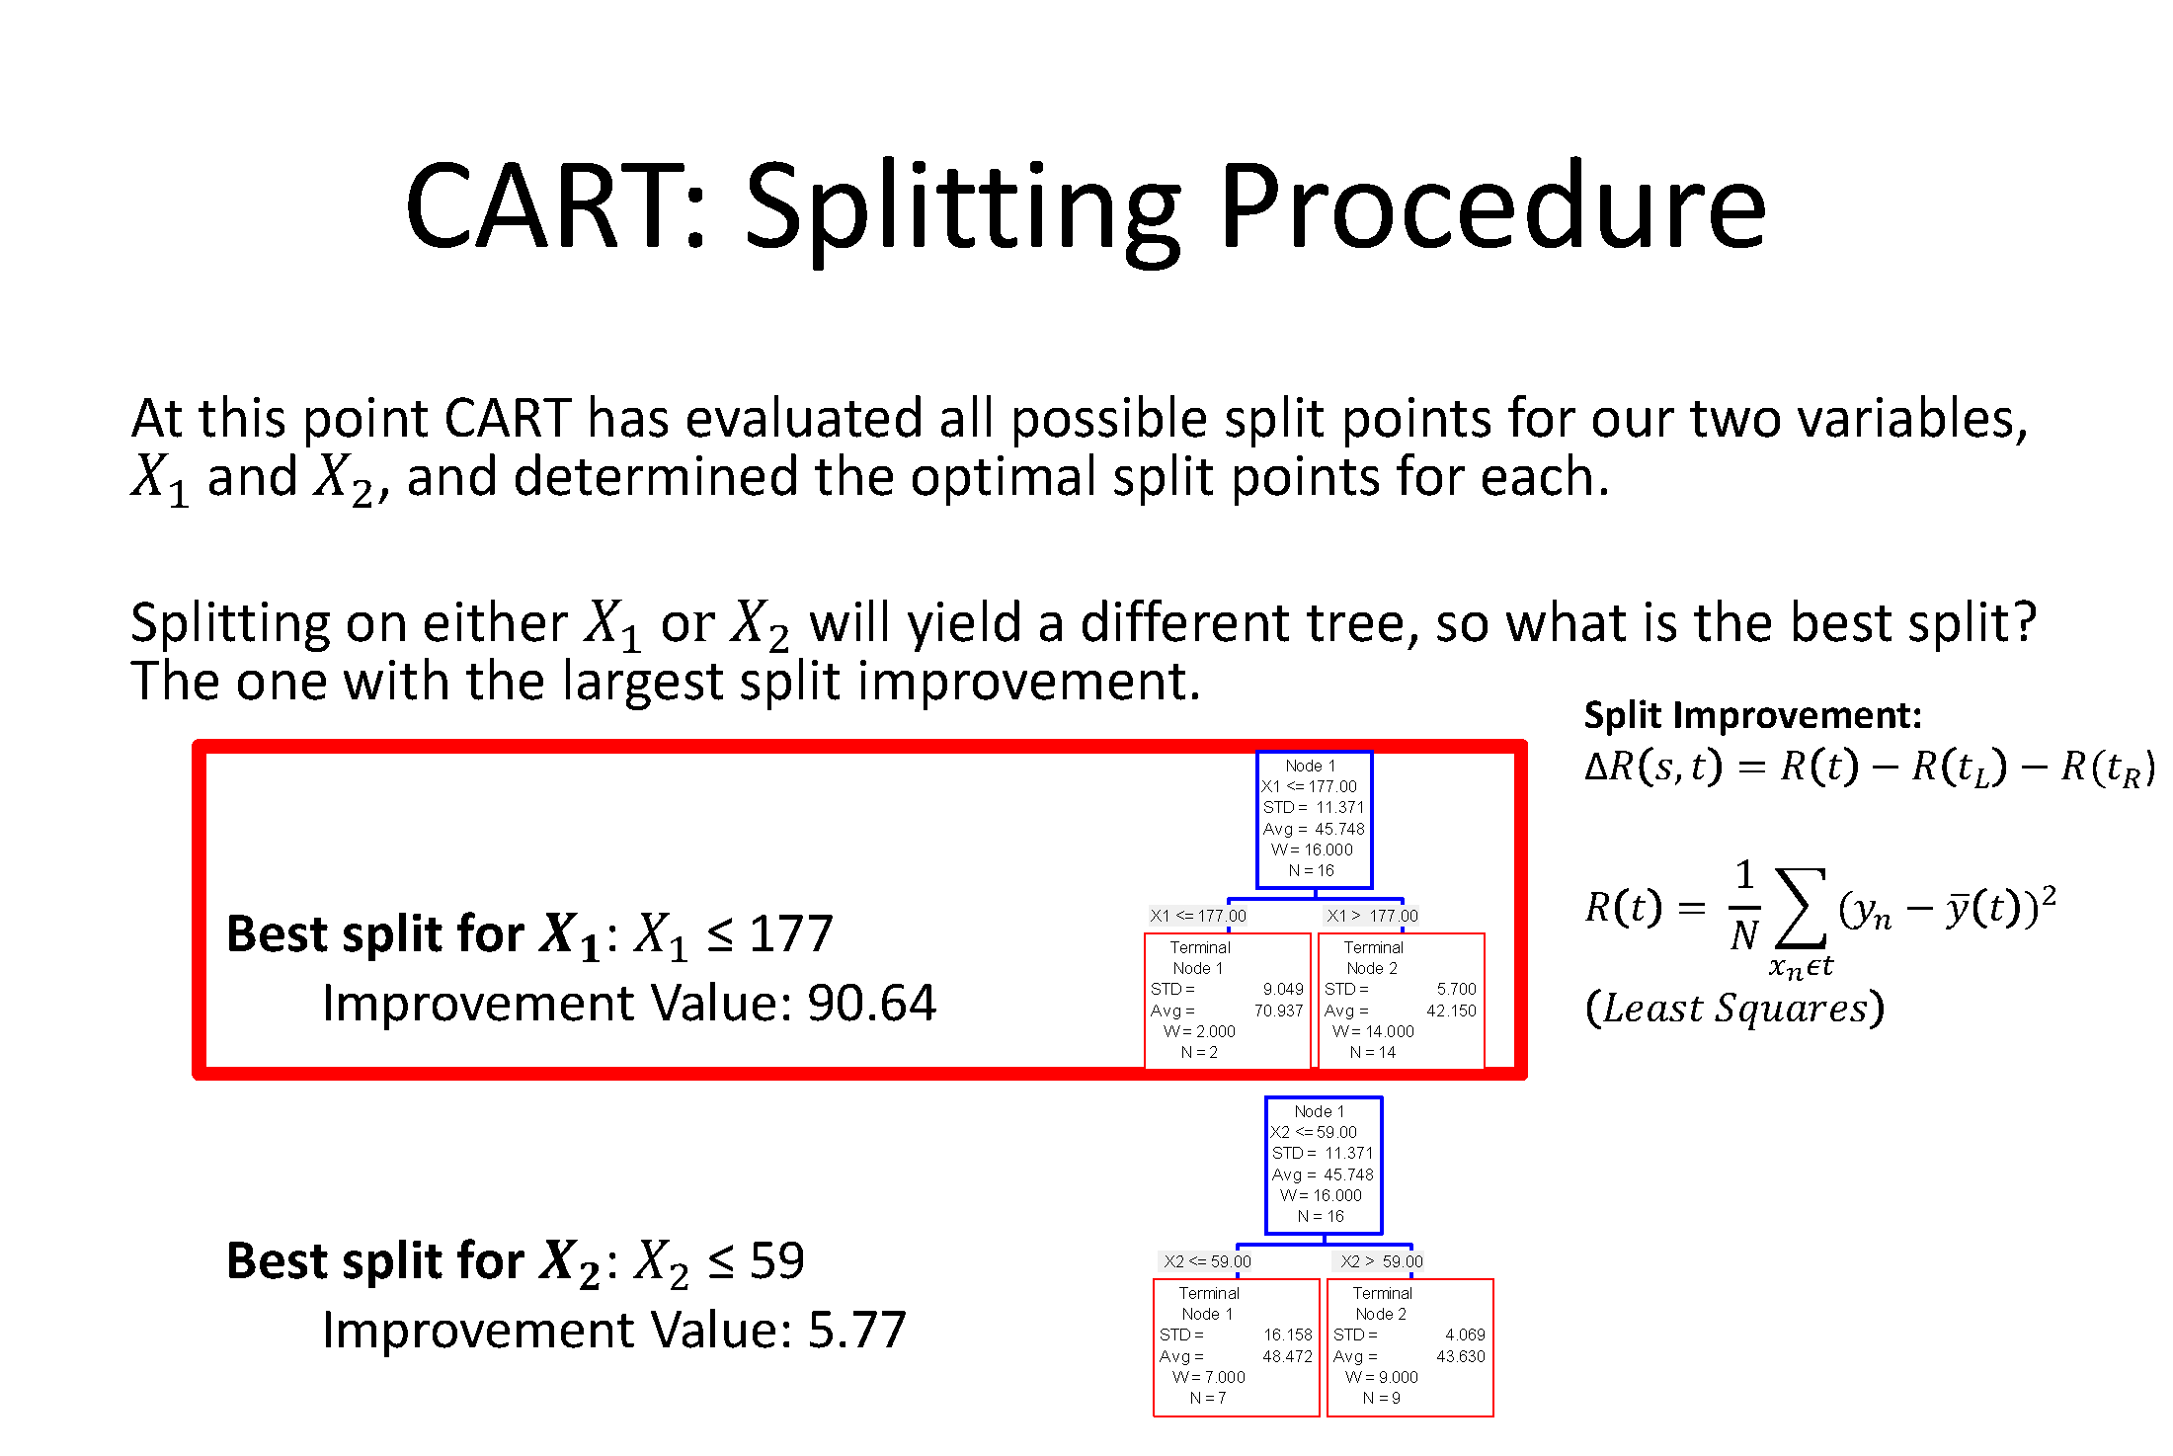

Slide 19
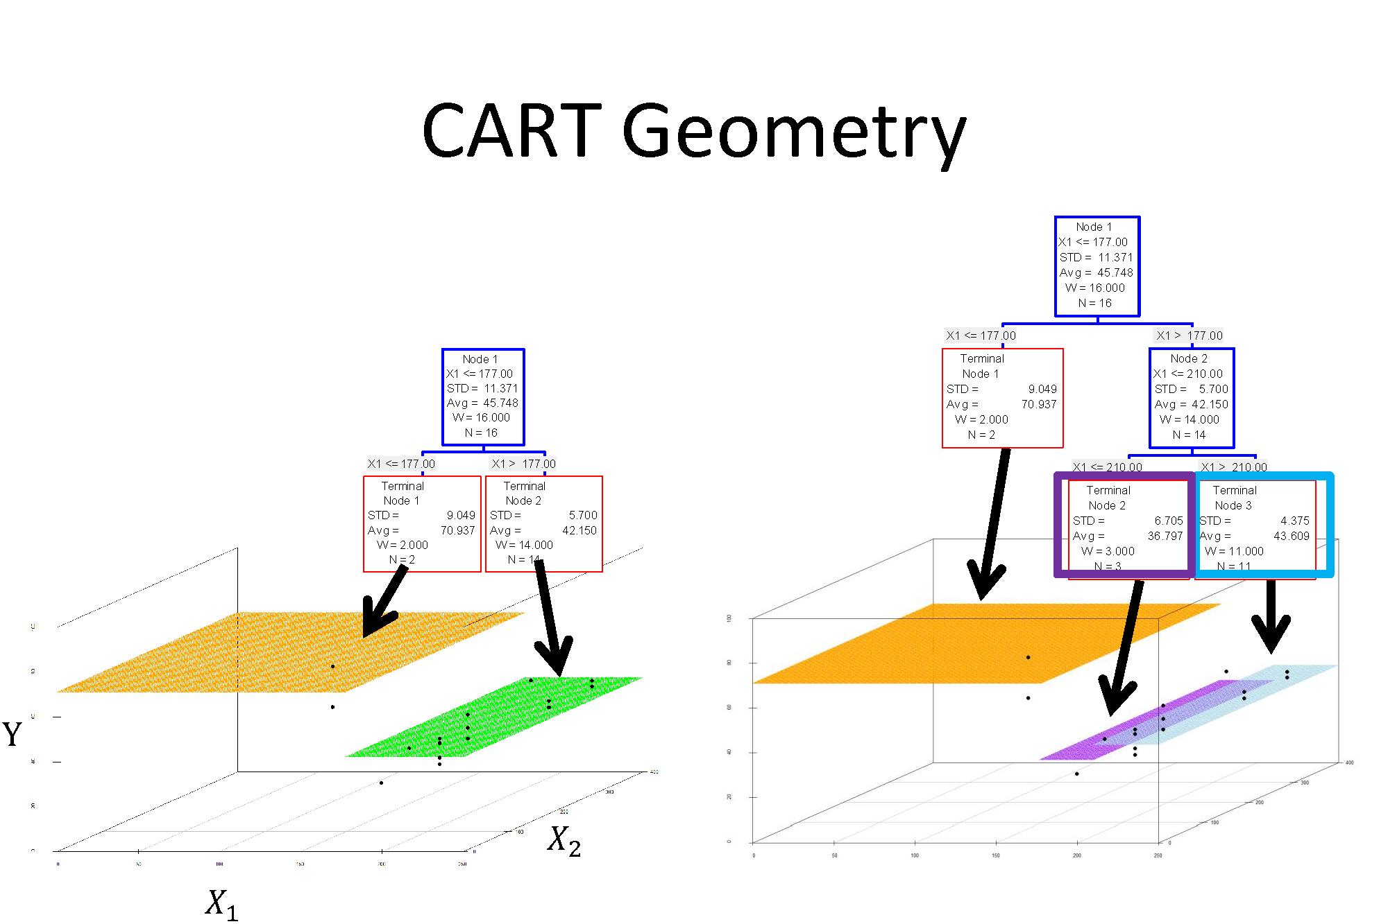

Slide 20
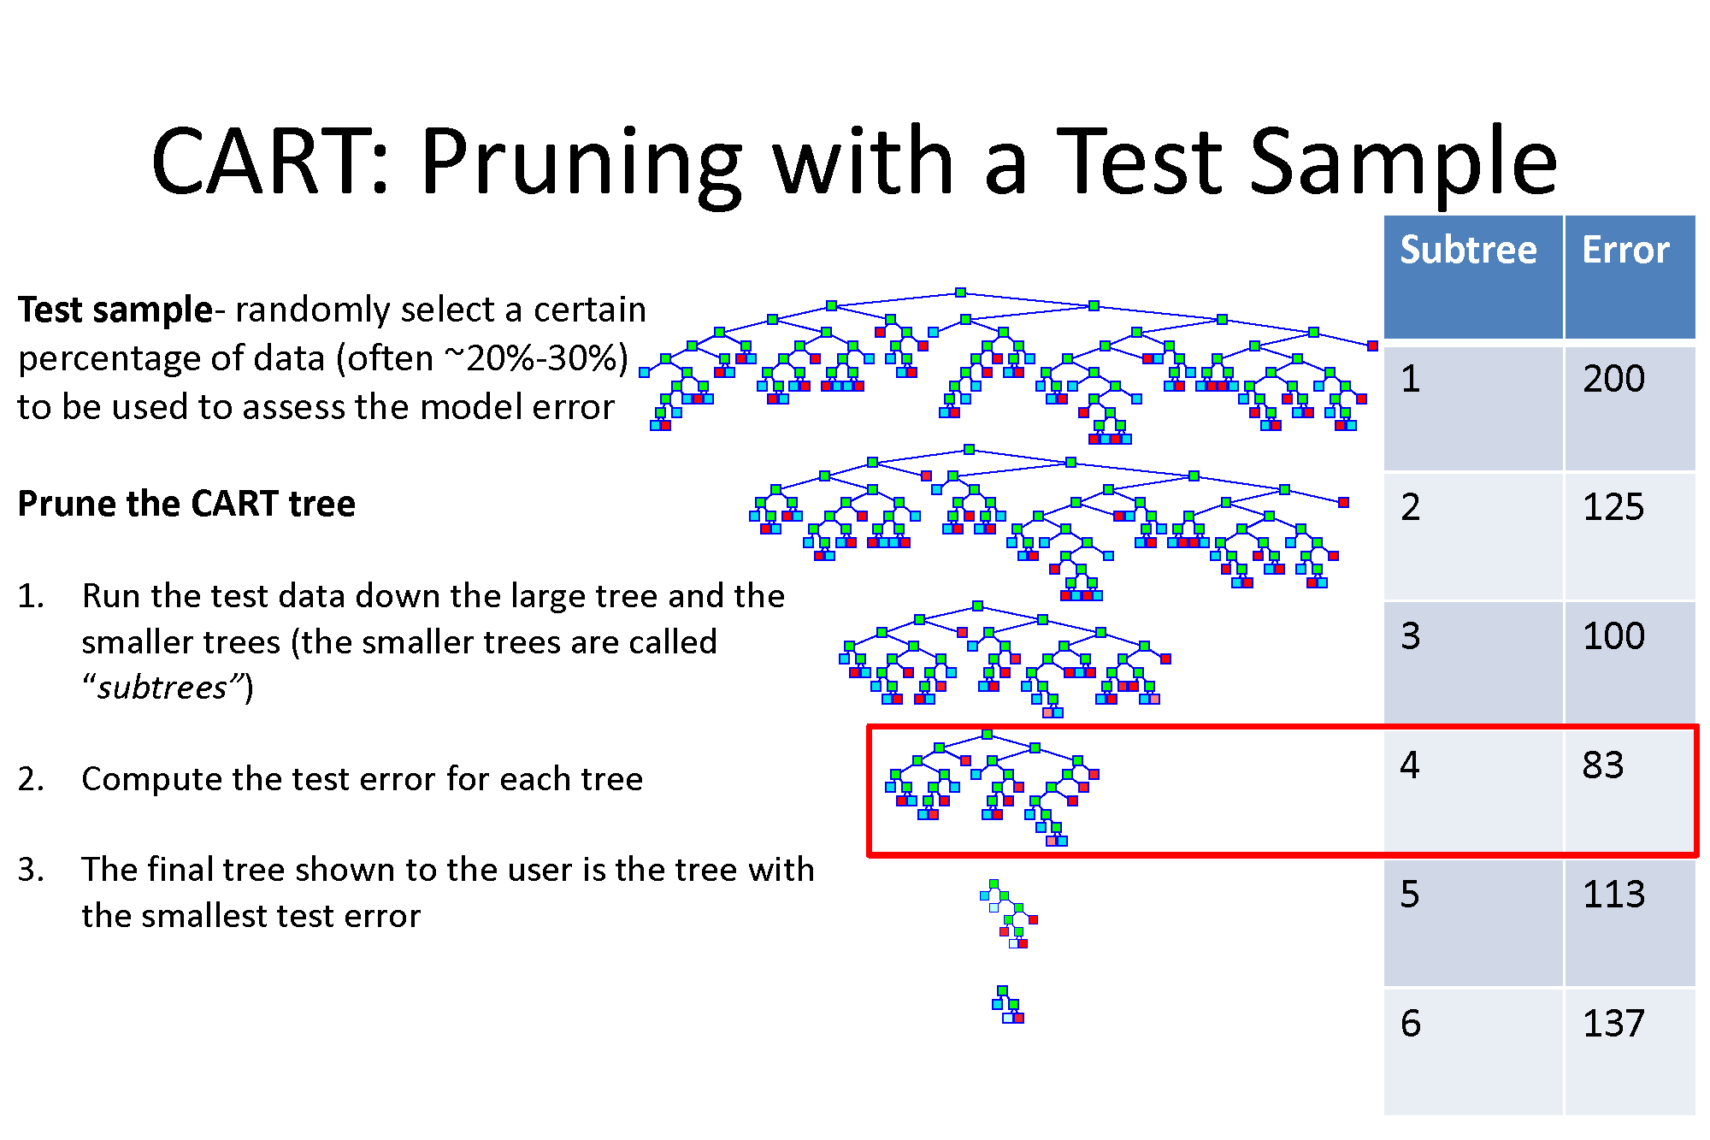

Slide 21
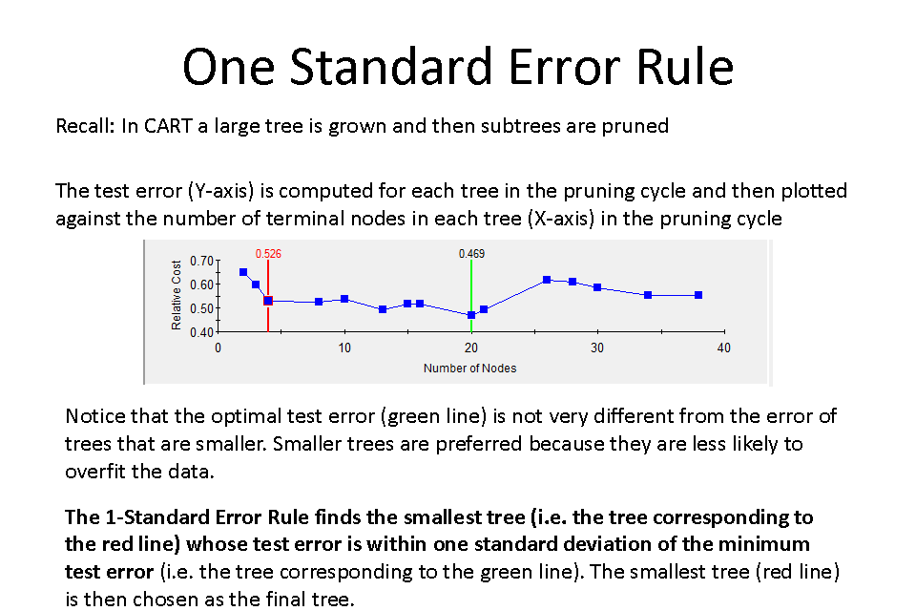

Slide 22
Internal Validation: Confusion Matrix
Producer’s accuracy
The probability of a reference pixel being correctly classified.
Omission error – samples are omitted from the correct class
User’s accuracy
The probability that a pixel classified on the map represents that category on the ground.
Commission error – samples are added to the incorrect class
Overall accuracy
Computed by dividing the total correct (i.e., the sum of the major diagonal) by the total number of pixels in the error matrix
Notes:
Also called contingency table or error matrix

Slide 23
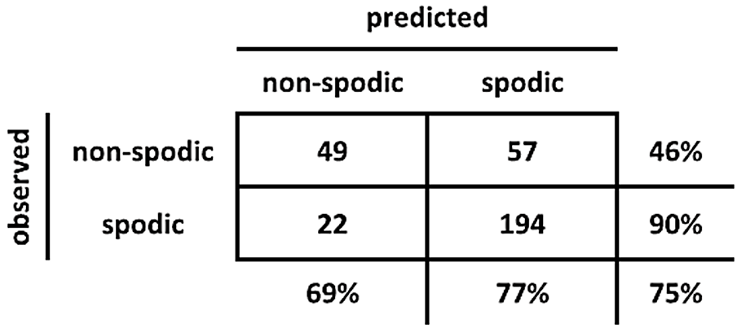
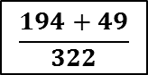
Confusion Matrix: Nauman et al., 2015
User’s
Accuracy
49/106
194/216
Producer’s
Accuracy
49/71
194/251
$$\frac{194+49}{322}$$
Overall
Accuracy
Notes:
Producer’s accuracy = how often are real features in the field correctly shown on the map? (1-omission)
User’s accuracy = how often is the class on the map actually truthful in reality; It takes errors of commission into account by telling the consumer that, for all areas identified as category X, a certain percentage are actually correct. (1-commission)
If you omit something from the correct category, you commit it to an incorrect category.

Slide 24
EXERCISE: rpart
https://github.com/ncss-tech/stats_for_soil_survey/blob/master/chapters/8_Tree_models/treemodels.md

Slide 25
Summary - rpart
rpart(formula, data, method, control)
formula response~predictor1+predictor2+predictorx
data= specifies the dataset
method= “class” for classification tree
“anova” for regression tree
control= optional parameters for controlling tree growth
printcp( ) | displays complexity parameter (cp) table
plotcp ( ) | plots cross-validation results
summary ( ) | detailed results including surrogate splits
plot ( ) | plots the decision tree
text ( ) | labels the decision tree plot
prune ( ) | snips off the least important splits using cp
rpart.plot ( ) prp ( ) | located in the rpart.plot package, these commands allow for better rpart plot customizations

Slide 26
randomForest algorithm
Grow a forest of many trees (ntree).
Grow each tree from an independent bootstrap sample from the training data (sample N cases at random with replacement).
For each tree at each node:
Select a random subset of predictor variables (mtry)
Use the best split on the selected mtry variables
Repeat this process until the tree is grown to the largest extent possible (no pruning)
Aggregate all trees for prediction (average for regression, majority vote for classification).
Notes:
Does not produce a single tree output like rpart because decisions are not made on a single binary tree….decisions are made using an ensemble of trees.

Slide 27
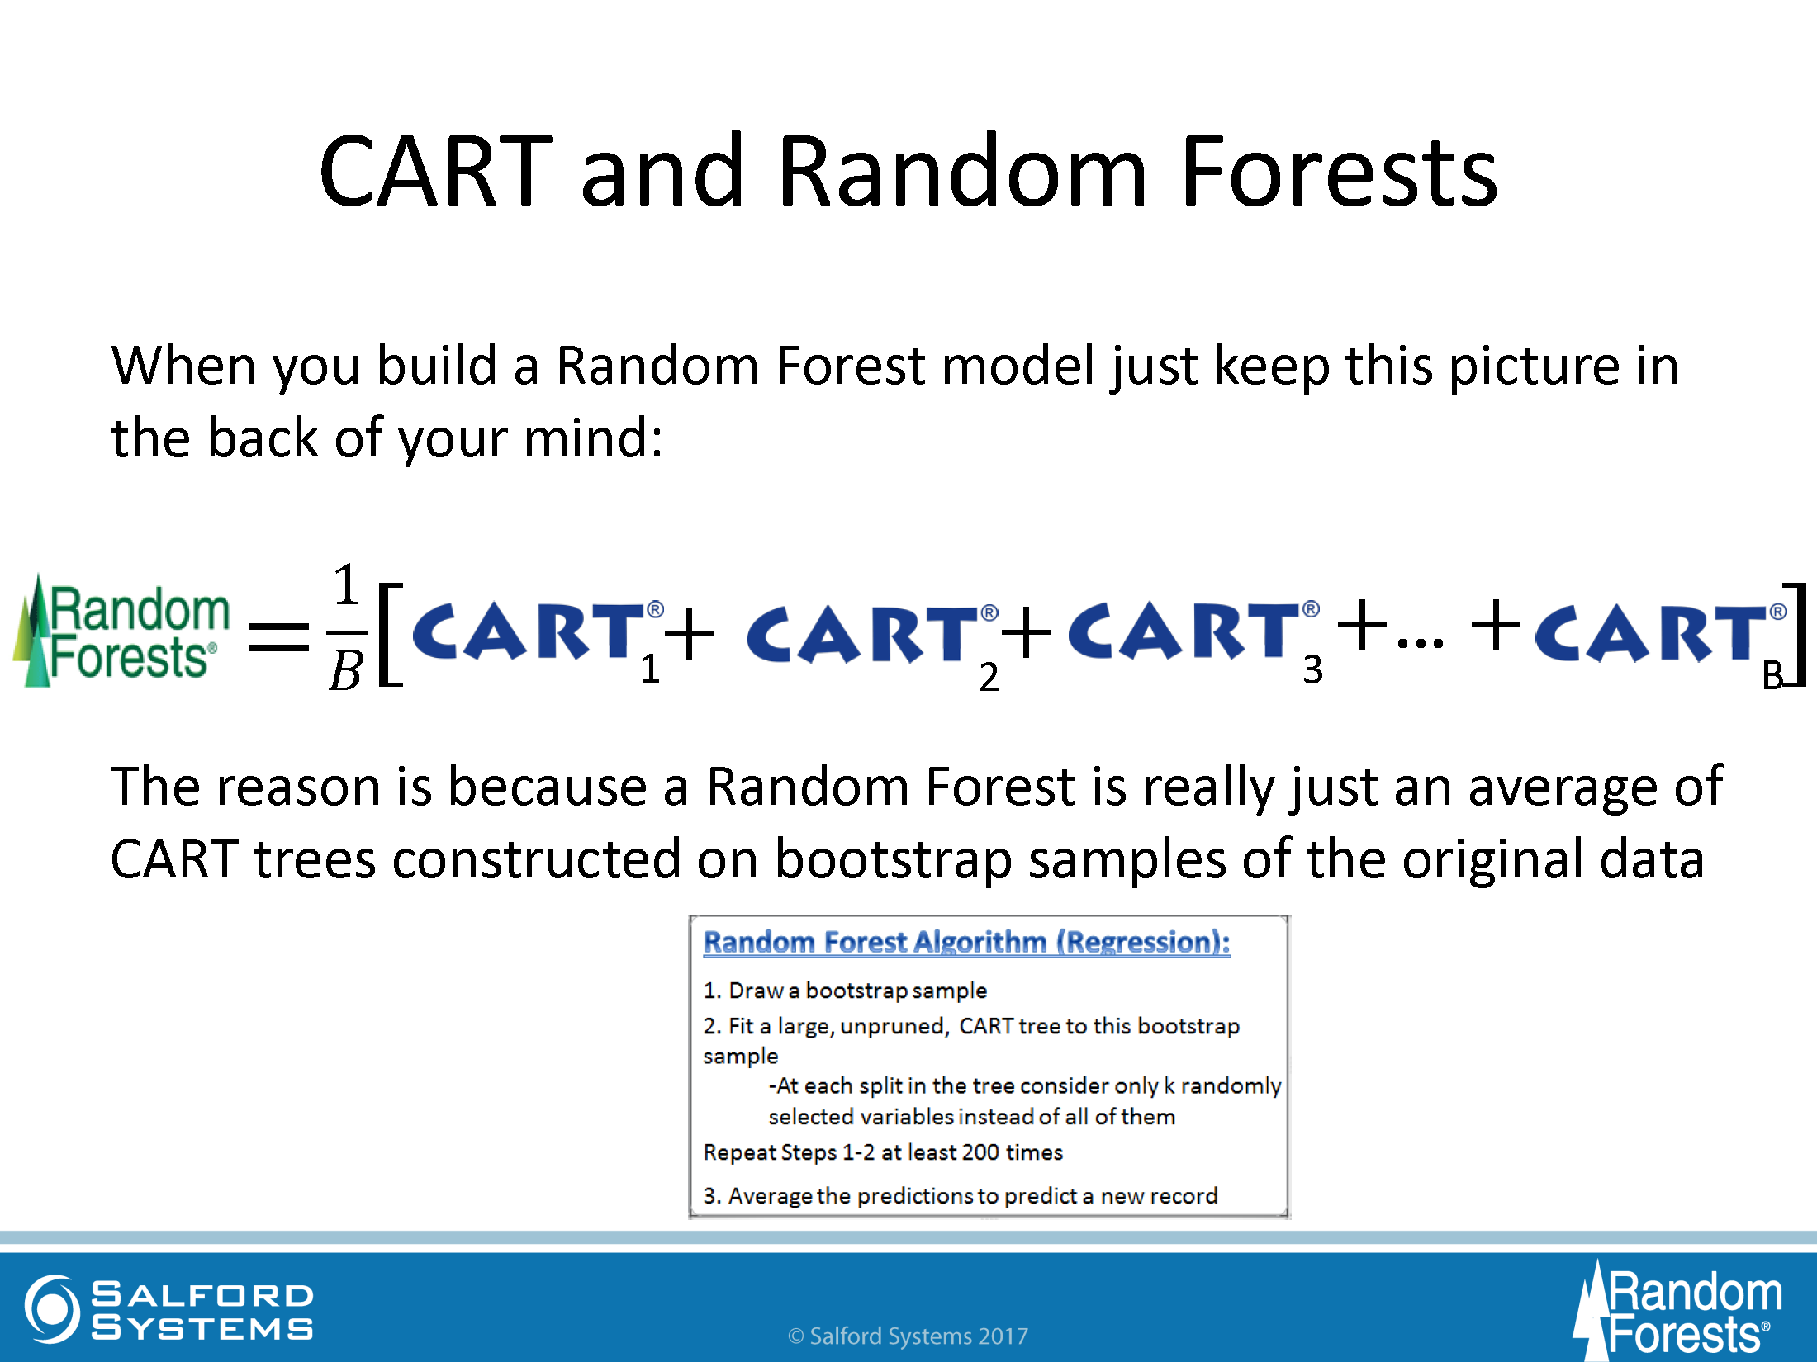

Slide 28
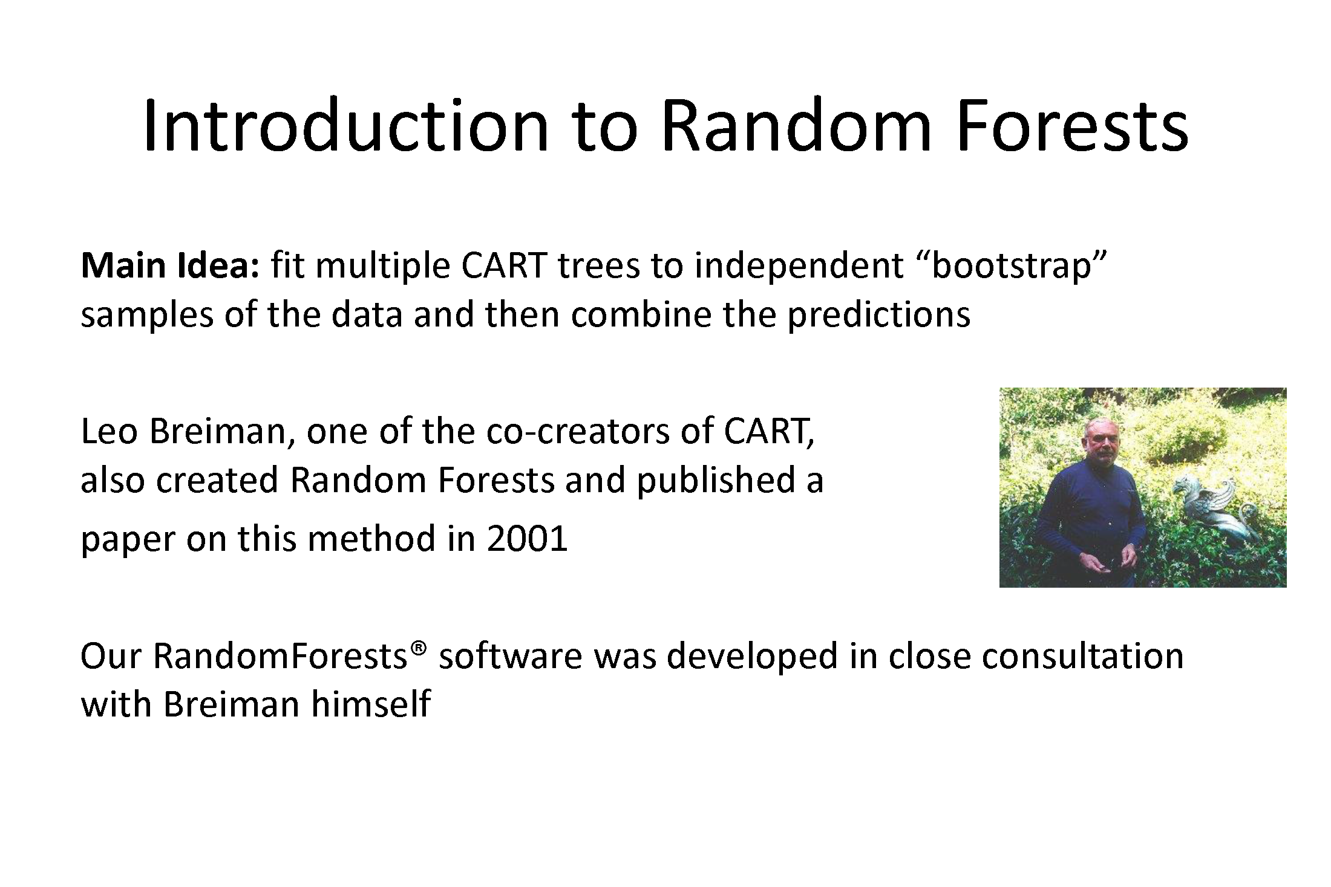

Slide 29
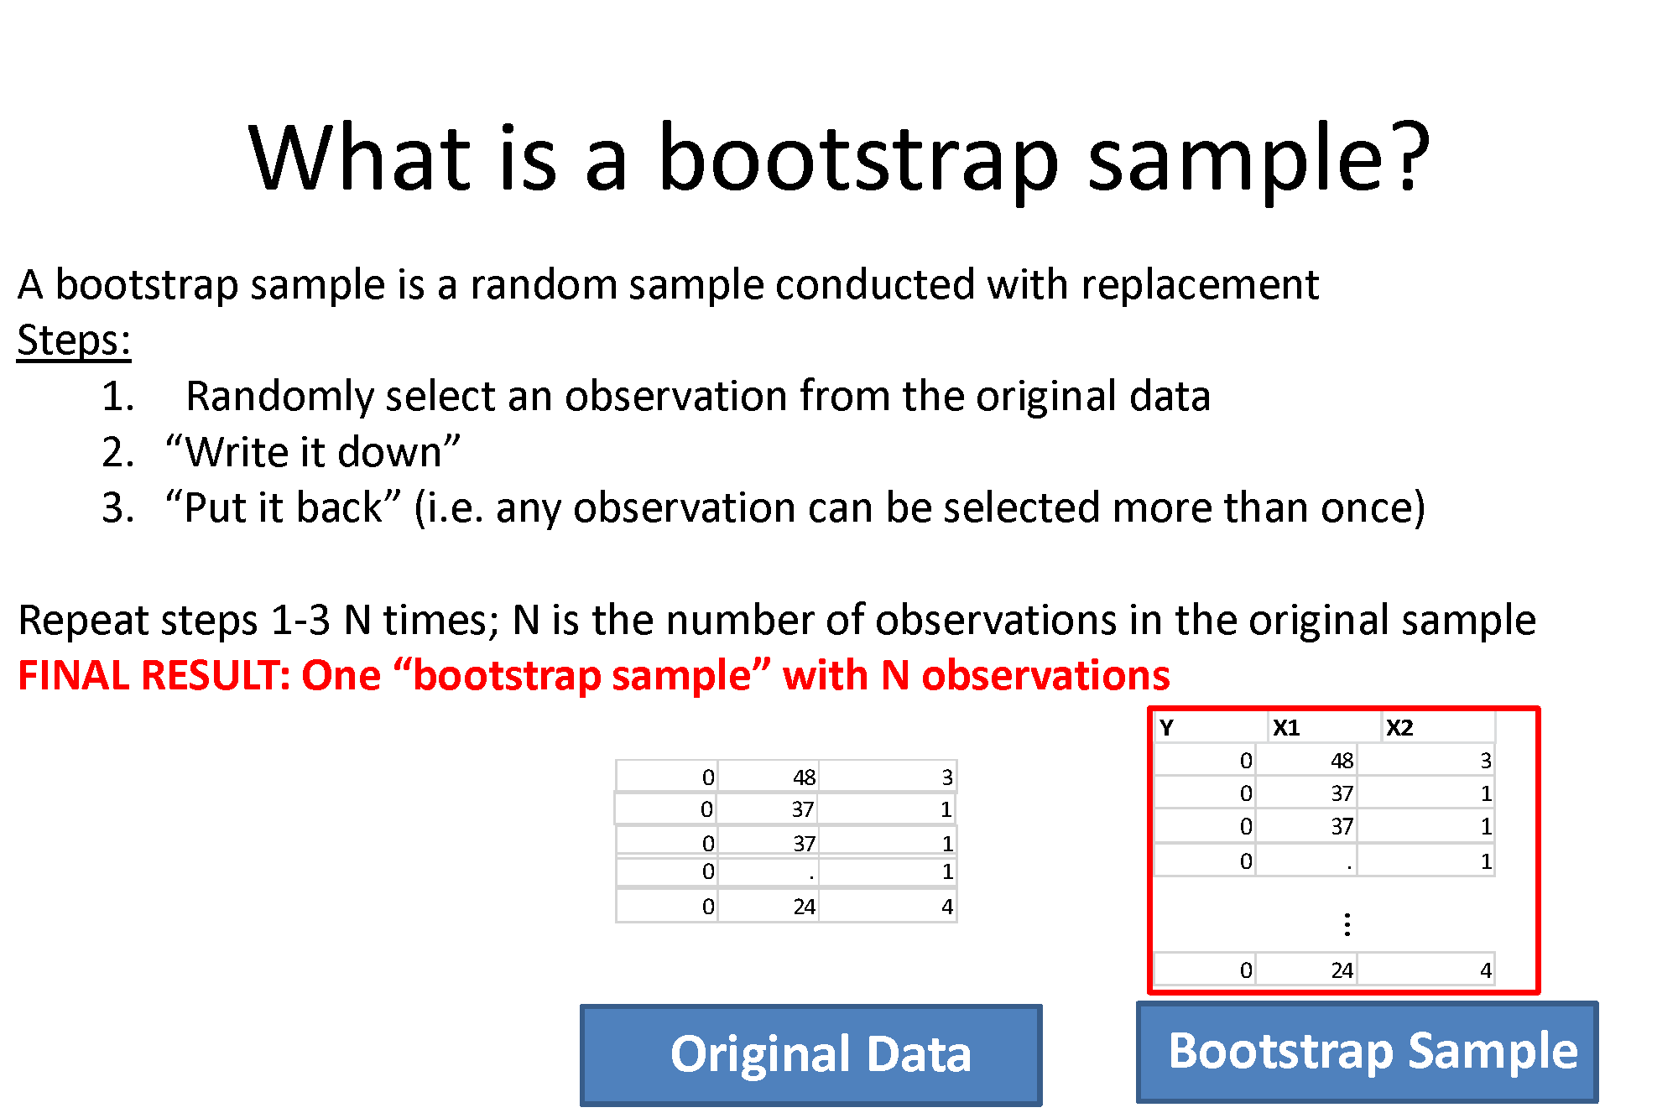

Slide 30
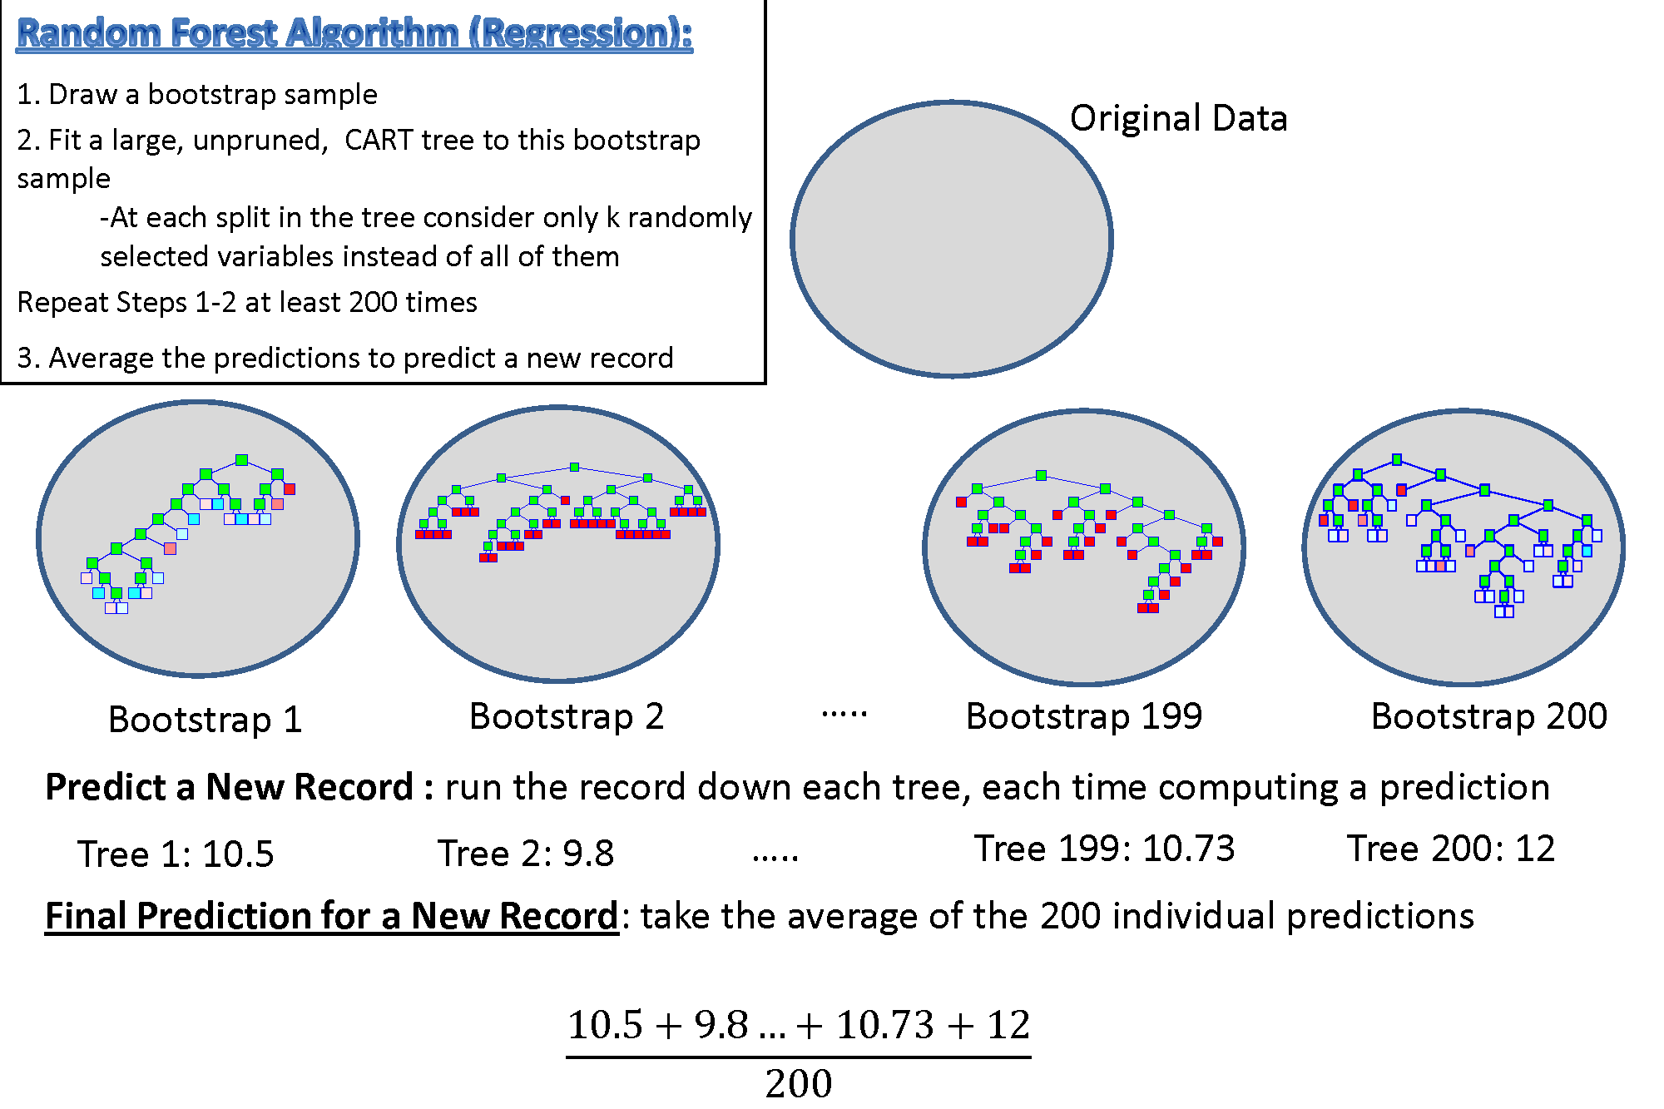

Slide 31
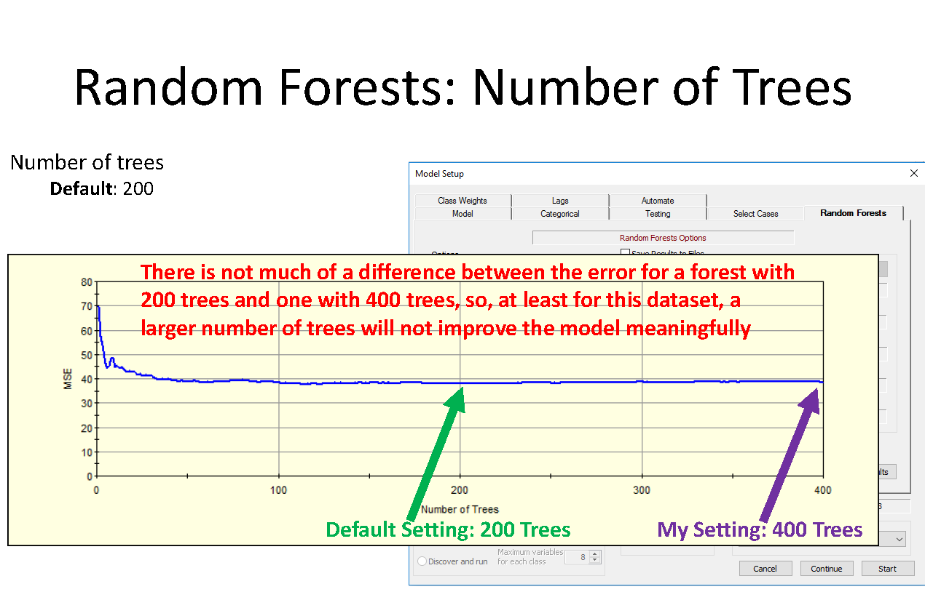

Slide 32
Classification Terms
Mean Decrease Accuracy
the more the accuracy of the random forest decreases due to the addition of a single variable, the more important the variable is deemed
Mean Decrease Gini
a measure of how each variable contributes to the homogeneity of the nodes and leaves
Out of Bag Error
proportion of times that the result is misclassified, averaged over all samples

Slide 33
Regression Terms
%Inc MSE
average increase in squared residuals of the test set when variables are randomly permuted (little importance = little change in model when variable is removed or added)
Inc Node Purity
increase in homogeneity in data partitions
Mean of Squared Residuals
sum of squared residuals divided by n
% Variance Explained
psuedo R²
Notes:
The %IncMSE is the difference between the prediction errors averaged over all trees, normalized by the standard deviation of the differences.
The IncNodePurity is measured by residual sum of squares as the total decrease in node impurities as a result of splitting on a given variable, averaged over all trees.

Slide 34
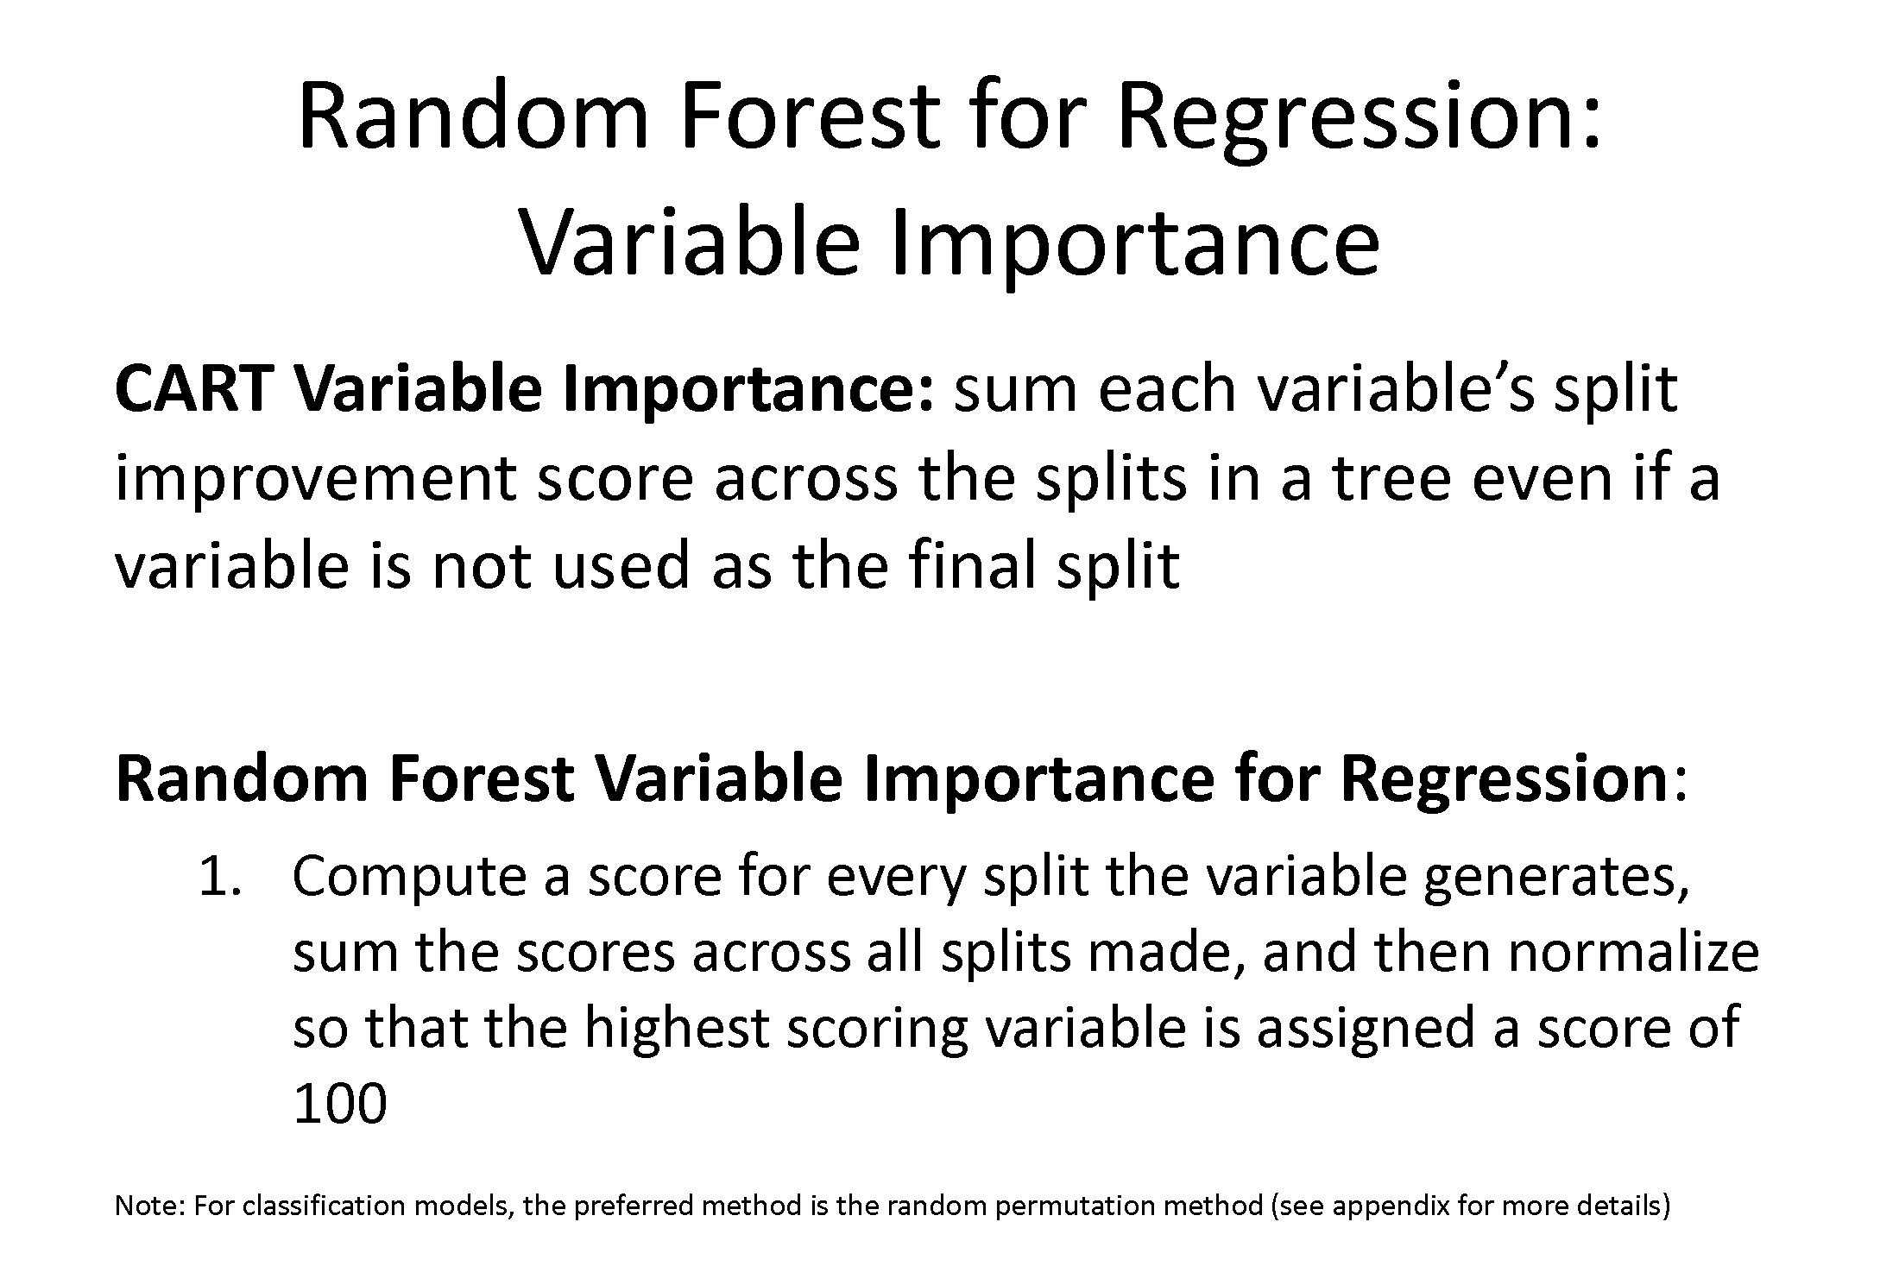

Slide 35
Variable Importance
The importance of each variable is estimated by observing how much the prediction error increases when out-of-bag (OOB) data for that variable are permuted while all others are left unchanged.

Slide 36
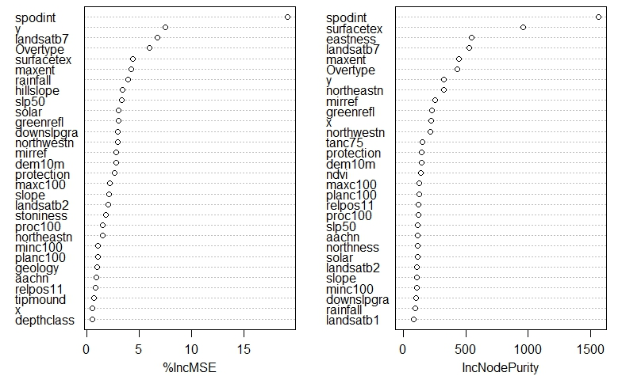
Variable Importance: Regression

Slide 37
EXERCISE: randomForest
https://github.com/ncss-tech/stats_for_soil_survey/blob/master/chapters/8_Tree_models/treemodels.md

Slide 38
Summary - randomForest
randomForest(formula, data, importance)
formula response~predictor1+predictor2+predictorx
data= specifies the dataset
mtry= number of randomly sampled variables at
each node
ntree= number of trees to grow
importance= if TRUE, allows user to examine variable importance
varImpPlot ( ) | variable importance plot
importance ( ) | variable importance statistics
plot ( ) | plots out of bag (OOB) error rate versus number of trees
print( ) | model summary statistics

Slide 39


Slide 40
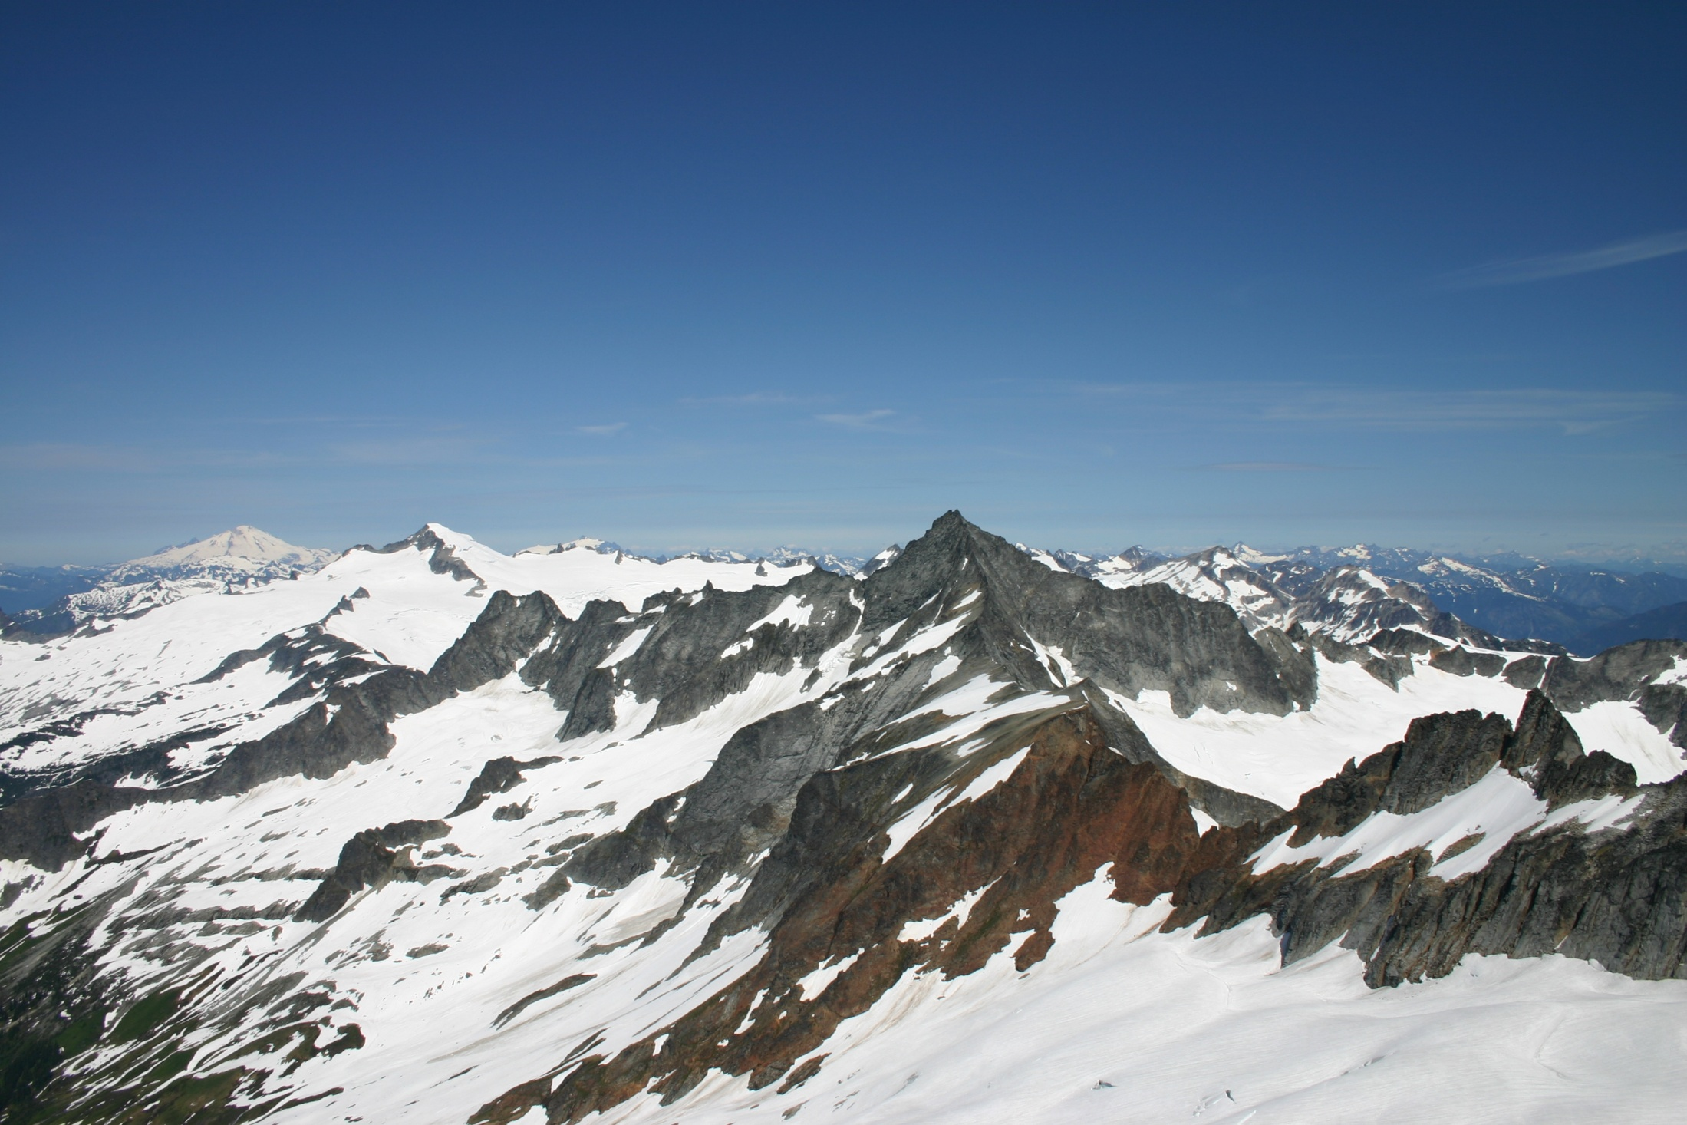
Landform Mapping of the North Cascades National Park, Washington
Phil Roberts - M.S. Thesis Research
Notes:
Look for better picture (field season or flight)‏

Slide 41

Digital Soil Mapping at :
Focus on Wilderness Areas in Washington
(Stephen T. Mather, Pasayten, Sawtooth, Henry M. Jackson)
1,335 km² have been mapped to date
(4th Order Surveys : sub-group level of S.T.)
Rodgers (2000) Ufnar (2004)
Briggs (2004) Meirik (2008)

Slide 42

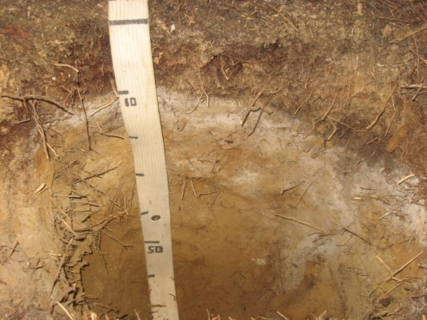
Objective
Evaluate the utility of automated landform classification for digital soil mapping
Research Questions:
Can we automate landform mapping using inductive, multivariate techniques?
Are soil classes and properties correlated with landform units in mountainous regions within the Pacific Northwest?
→

Slide 43
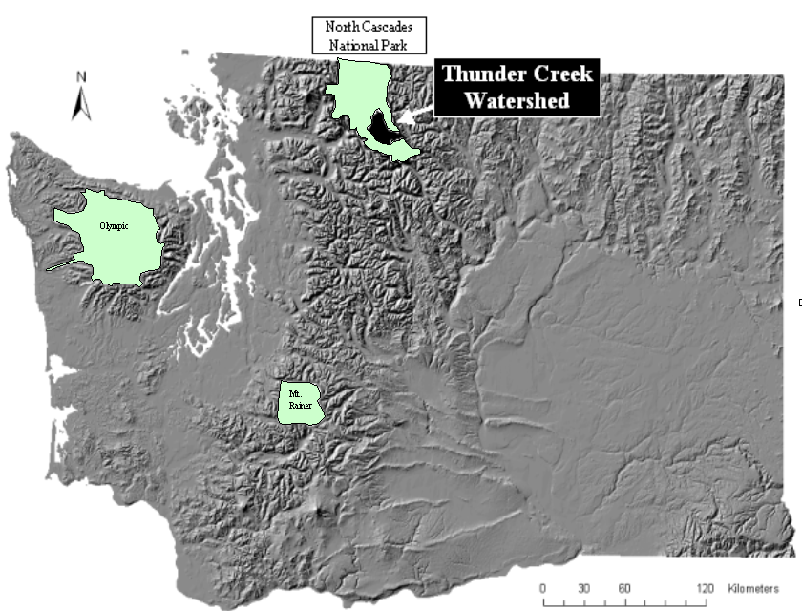
STUDY
AREA

Slide 44
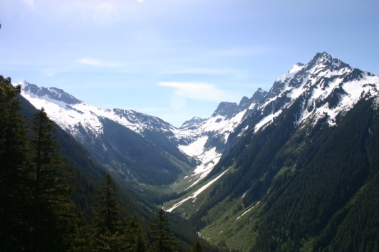
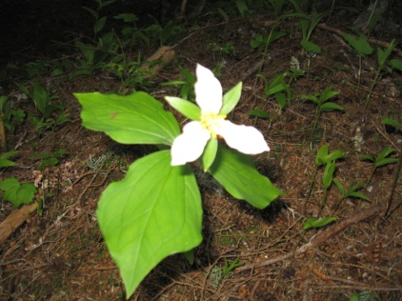
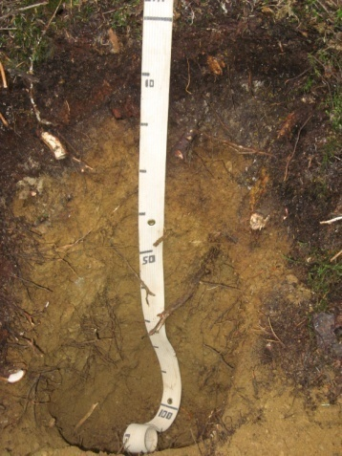
Methods – Field Work
Observe / Describe / Classify:
Geomorphic Characteristics
slope, aspect, curvature, elevation, landform, landform position
Vegetation Characteristics
species present, heights, age, DBH, abundance, distribution
Soil Profile Characteristics
color, texture, structure, horizination

Slide 45
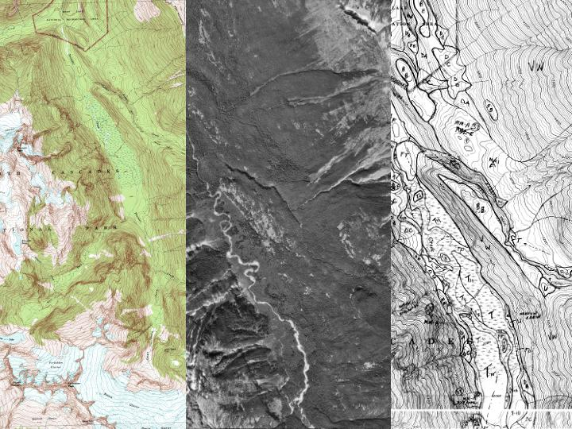

Slide 46
High Elevation:
Horn, Ridge, Pass, Arete, Cirque, Moraine…
Transitional Units:
Valley Wall, Debris Apron, Bedrock Bench, River Canyon, Mass Movements…
Valley Floor Units:
Flood Plain, Valley Bottom, Terraces, Debris Cone, Alluvial Fan…
grouped into 5 general categories for analysis:
uplands
backslopes
mass movements
footslopes
toeslopes

Slide 47
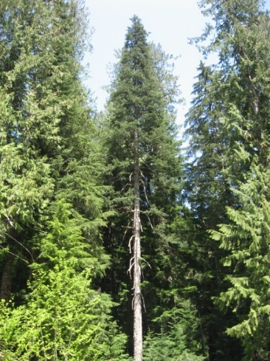
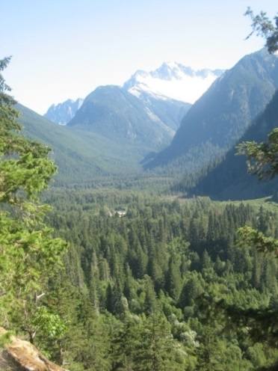
Landform Classification Techniques
DEM terrain attributes landform elements
Classification Methods:
Binary Decision Trees Random Forest
Calibration/Validation:
random 2/3 calibration 1/3 validation (286 / 143)
clusters remain intact

Slide 48

US-NPS Expert Landform Map
Kappa = 0.59
Overall Accuracy = 70%

Slide 49

Binary Decision Tree
Kappa = 0.37
Overall Accuracy = 53%

Slide 50
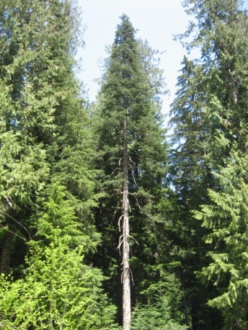
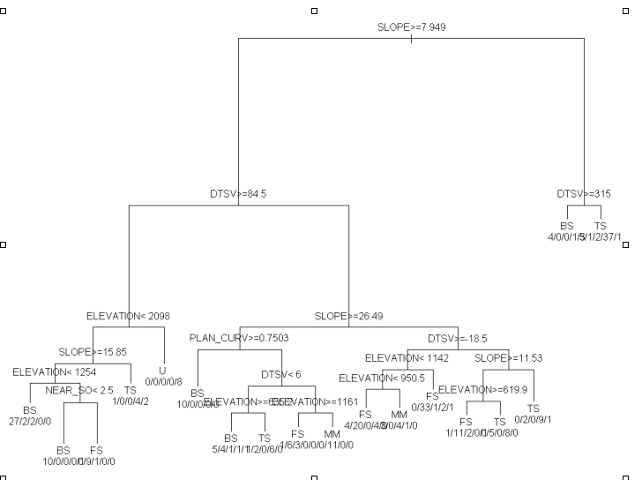
Results of the recursive partitioning and classification tree analysis showing decision rules and output classes of landform elements.

Slide 51

Random Forest
Kappa = 0.45
Overall Accuracy = 59%

Slide 52

RF Variable importance
(bold values indicate the most important
predicting variable for each landform class).

Slide 53
Landform Mapping Summary
Automated mapping approached expert mapping
59% vs. 70% Overall Accuracy
Random Forest performed best
59% Overall Accuracy vs 53% for BDT
Field observations focused on transitional areas
Slope was most important terrain attribute
elevation, distance above stream

Slide 54
Watershed
Mapping with
BDT model:

Slide 55

Binary Decision Trees
(Observation values in thousands)
Kappa = 0.36
Overall Accuracy = 58%

Slide 56
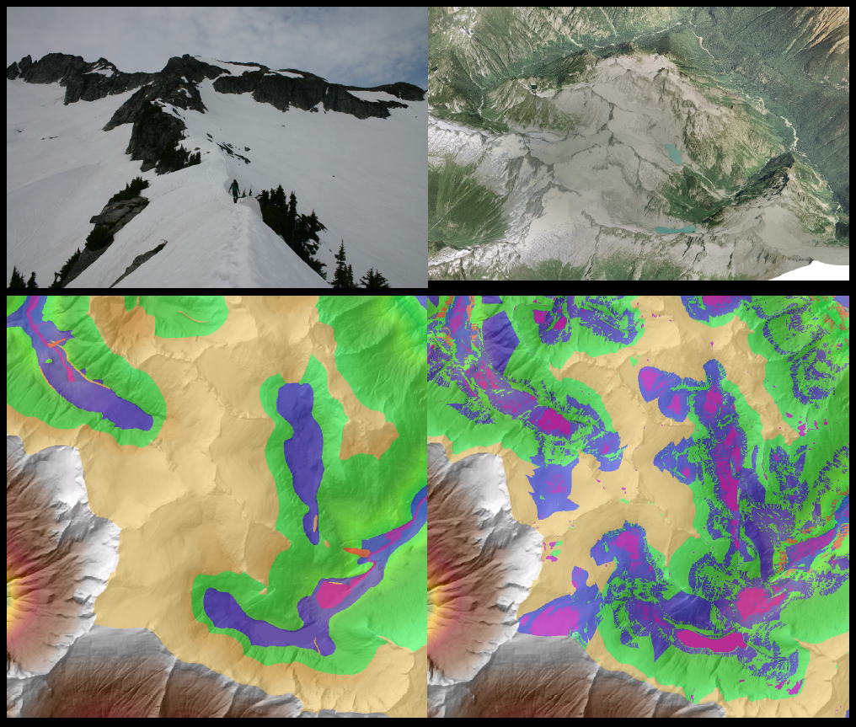
Upland landscape photograph looking northeast
3D visualization of Eldorado ice-cap (looking northeast)

Slide 57


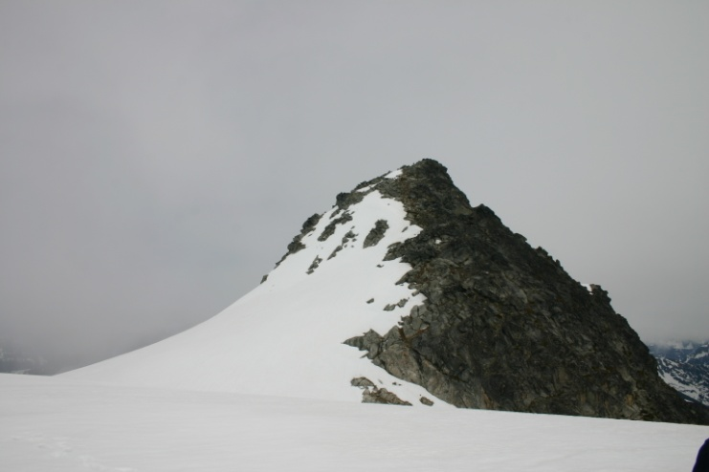




Slide 58
Watershed
Mapping with
RF model:

Slide 59
Random Forest
(Observation values in thousands)
Kappa = 0.40
Overall Accuracy = 61%

Slide 60
3D visualization of Thunder Creek south of the confluence with Fisher Creek (looking south)
Toeslope landscape photograph looking south

Slide 61
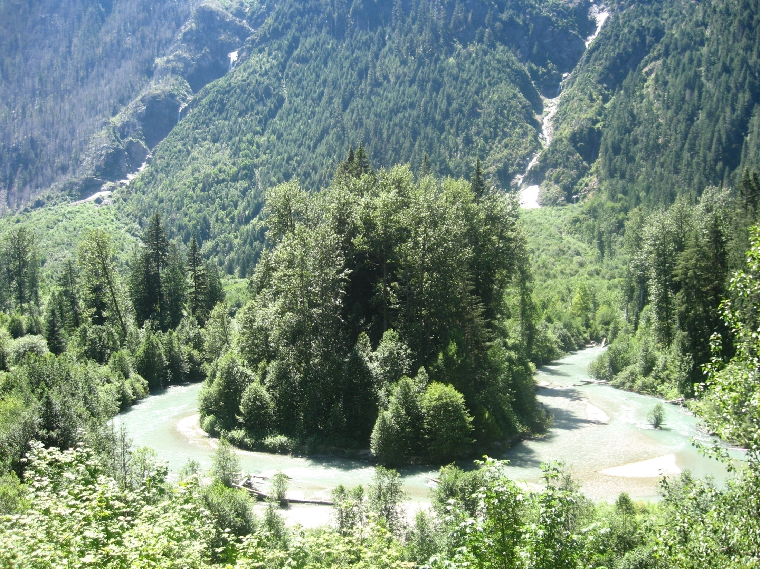

Slide 62
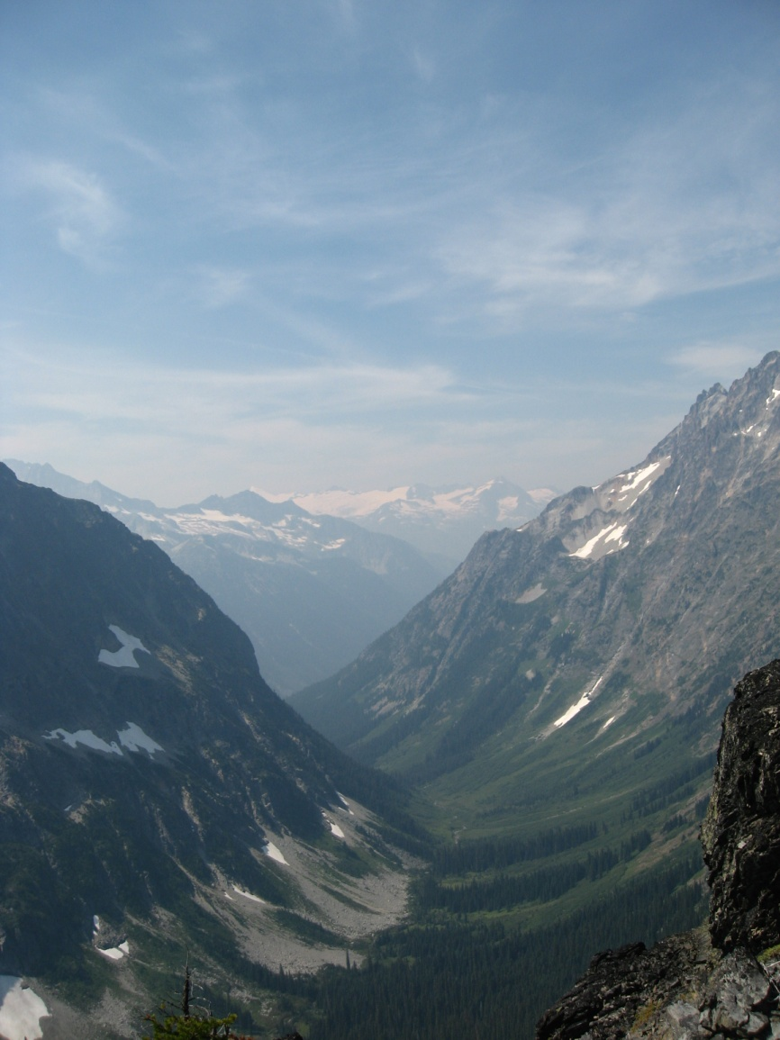
Zonal Statistical Analyses:
u
bs
mm
fs
ts

Slide 63
Summary – Tree Models
Tree-based models are quick, intuitive, nonparametric, and are often ideal for exploratory data analysis and prediction
Both rpart and randomForest packages perform internal validation (rpart=10-fold cross validation; randomForest=OOB error estimates)
In general, tree-based models are robust against multicollinearity and low n, high p datasets
Caveats
Outliers (model stability and over-fitting)
Model parameters (pruning for rpart; ntree and mtry for randomForest)

Slide 64

Always Remember…
“The combination of some data and an aching desire for an answer does not ensure that a reasonable answer can be extracted from a given body of data.”
–John Tukey
http://www.amstat.org/about/statisticiansinhistory/index.cfm?fuseaction=biosinfo&BioID=14

Slide 65
Review Questions
Why is random forest often referred to as double random?
How does random forest perform internal validation?
True or false – numerical and categorical data can be used in the creation of a classification tree?
What are some differences between rpart and randomForest?
Why is random forest often referred to as double random?
How does random forest perform internal validation?
True or false – numerical and categorical data can be used in the creation of a classification tree?
What are some differences between rpart and randomForest?
Why is random forest often referred to as double random?
How does random forest perform internal validation?
True or false – numerical and categorical data can be used in the creation of a classification tree?
What are some differences between rpart and randomForest?
Why is random forest often referred to as double random?
How does random forest perform internal validation?
True or false – numerical and categorical data can be used in the creation of a classification tree?
What are some differences between rpart and randomForest?

Slide 66


